Slide 1

ARTIFICIAL
INTELLIGENCE
This presentation will introduce AI model project,
highlighting its objectives, methodologies, and potential impact
HAND WRITTEN DIGIT RECOGNITION

Slide 2


CONTENT
INTRODUCTION TO AI & DL
OVERVIEW
LIBRARIES USED
METHODOLOGY
DATA
MODELS DEVELOPMENT
FUTURE & USAGES
RESULT
00

Slide 3
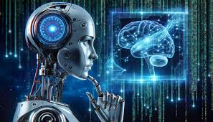
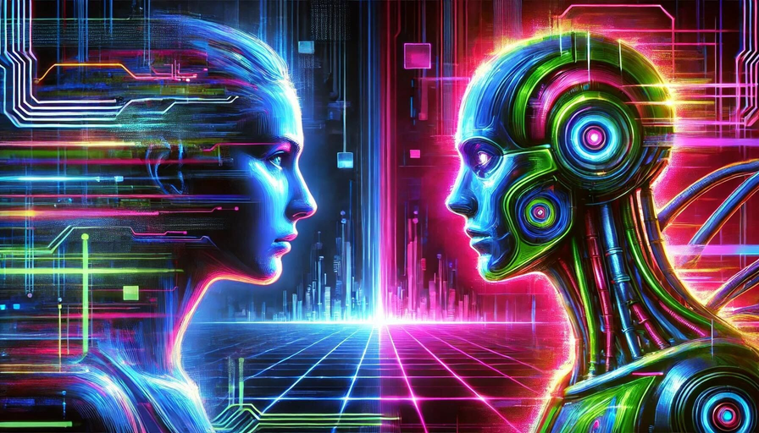
AI
The ability of computer systems to perform tasks that typically require human intelligence
AI means making machines act like humans by learning, solving problems, making decisions, and understanding language. It includes areas like machine learning, language processing, and robotics..
Deep Learning
a type of artificial intelligence (AI) that uses artificial neural networks to teach computers how to process data in a way that resembles the human brain:
Deep Learning is a subset of machine learning that uses neural networks with many layers (hence "deep") to automatically learn and extract features from data.

Slide 4
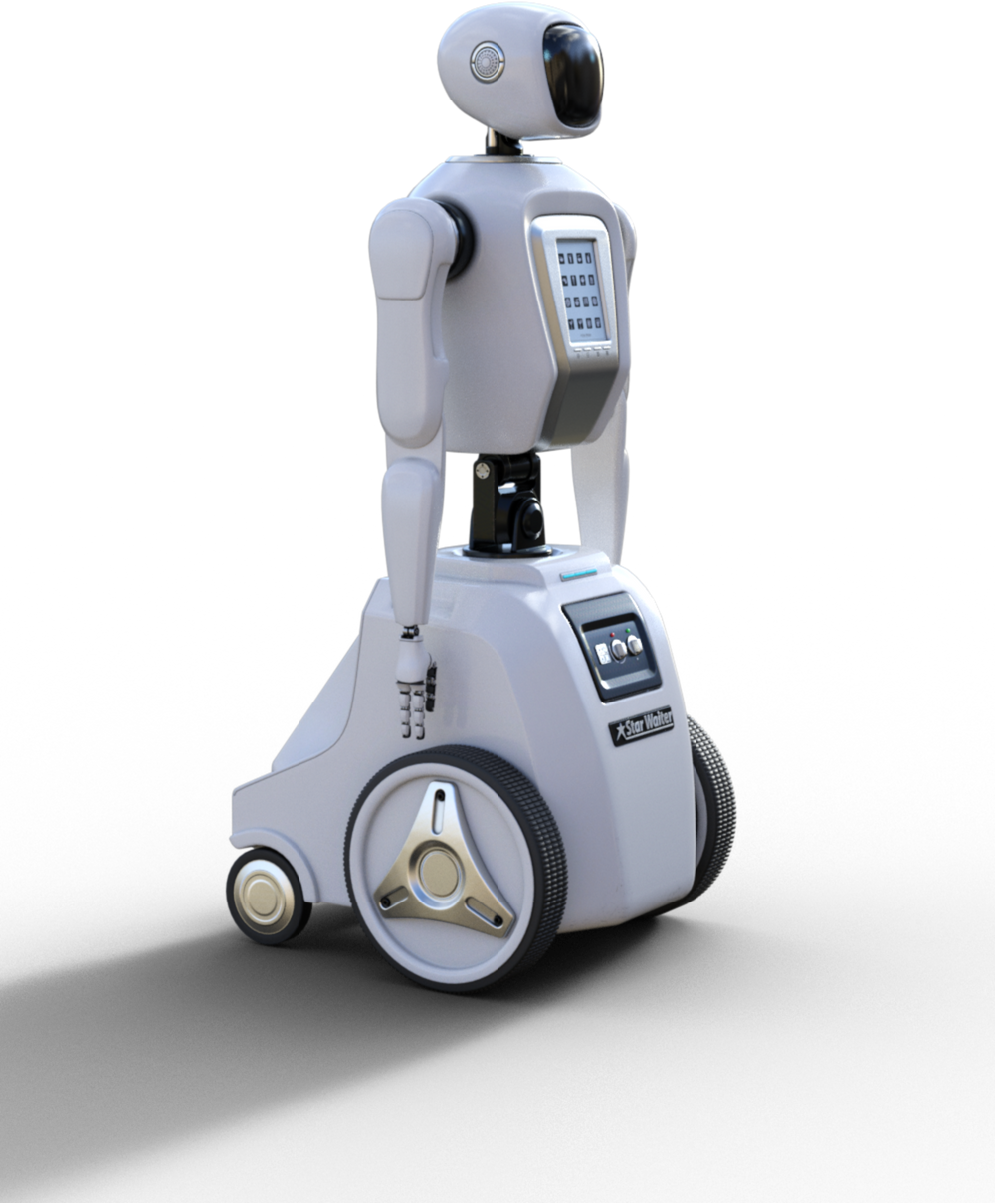
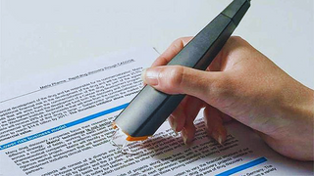
PROJECT OVERVIEW
Handwritten Digit Recognition Using AI
Objective:
Build a machine learning model to recognize handwritten digits (0–9).
Dataset:
MNIST Dataset:
70,000 grayscale images (28x28 pixels).
60,000 for training, 10,000 for testing.
Model Overview:
Architecture: Neural Network or Convolutional Neural Network (CNN).
Input: 28x28 pixel grey scale images. (a black-and-white image or monochrome image)
Output: Predicted digit (0–9).
Implementation Steps:
1.Load and preprocess the MNIST dataset.
2.Design and train the model.
3.Evaluate the model's accuracy on unseen data.
Applications:
Optical Character Recognition (OCR).
Automation in data entry and document processing.
Results:
Achieved high accuracy (~98%) with CNNs on test data.

Slide 5
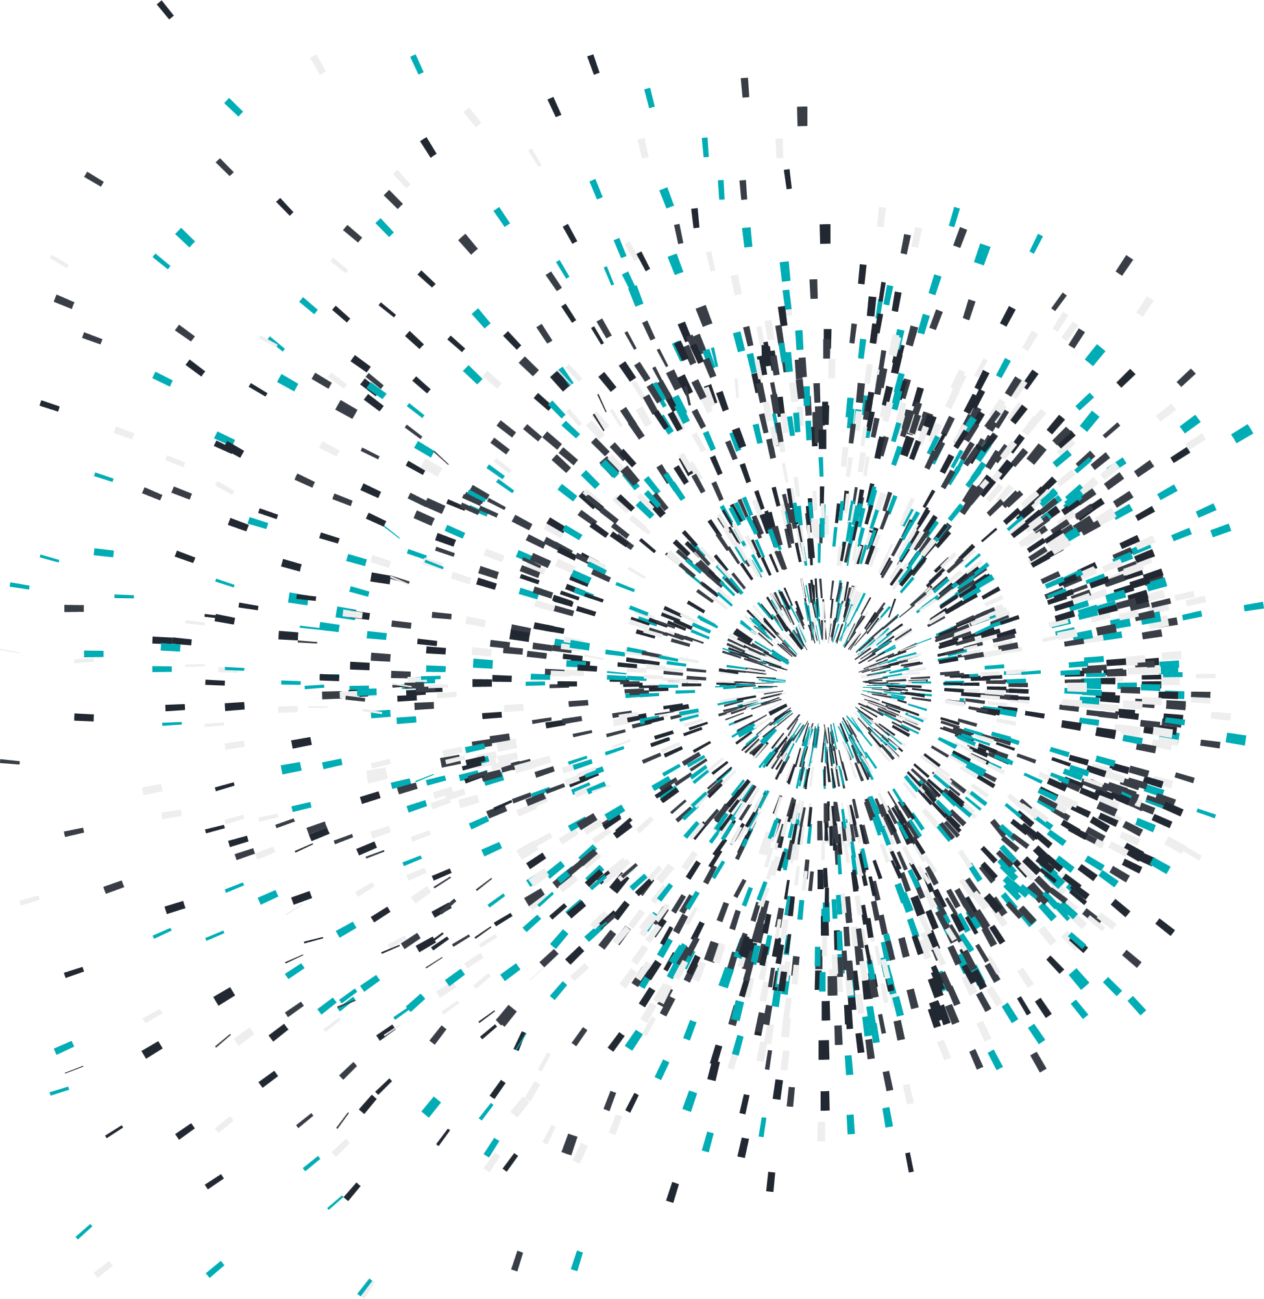
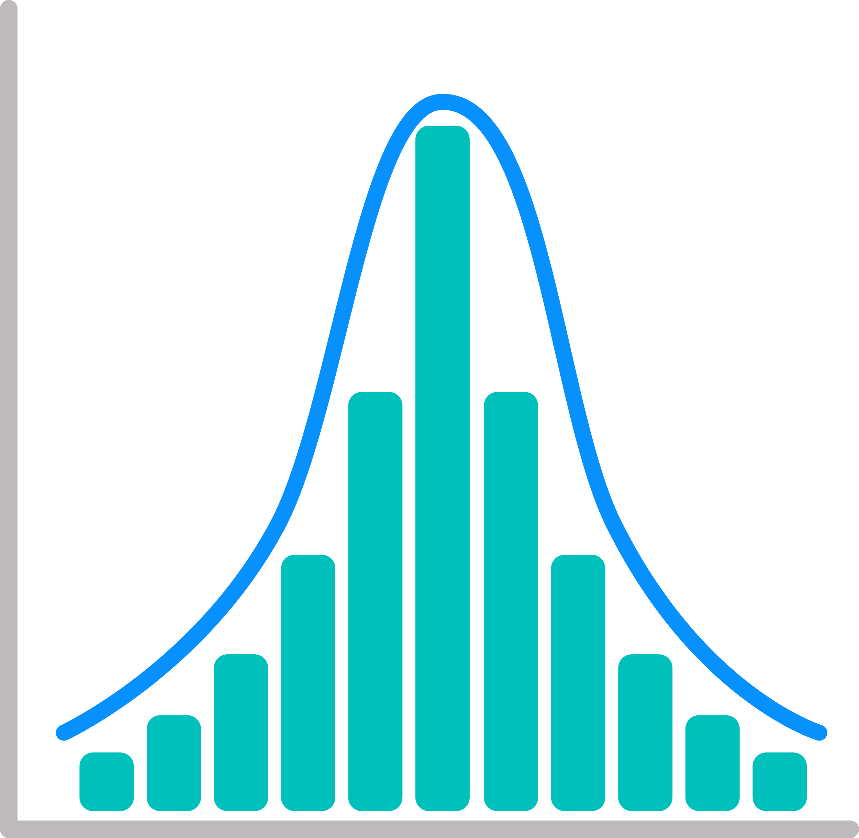
Introduction
HANDWRITTEN DIGIT RECOGNITION IS A
FUNDAMENTAL DEEP LEARNING TASK USING NEURAL NETWORKS.
THIS PROJECT IMPLEMENTS CNN, RNN (LSTM), AND SVM FOR CLASSIFYING HANDWRITTEN DIGITS FROM THE MNIST DATASET.

Slide 6
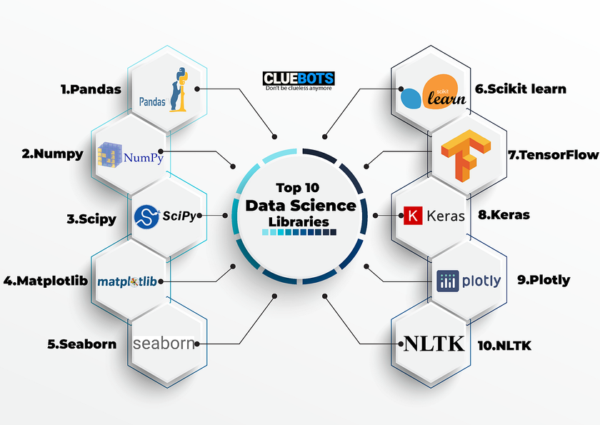


Purpose: This installs essential Python libraries for building, training, and visualizing a deep learning model.
pandas: Manages datasets in tabular format.
numpy: Performs numerical calculations.
torch: A deep learning framework used for building and training AI models.
torchvision: Provides utilities and prebuilt datasets for computer vision tasks like image processing.
matplotlib: Helps visualize data in charts, graphs, and images.
Libraries
Pandas
Numpy
Torch
Torchvision
Matplotlib

Slide 7
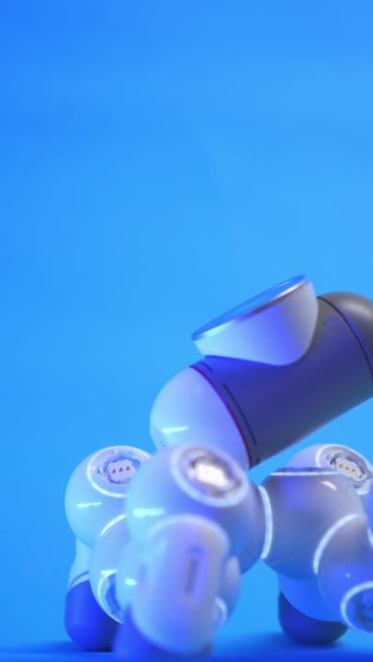
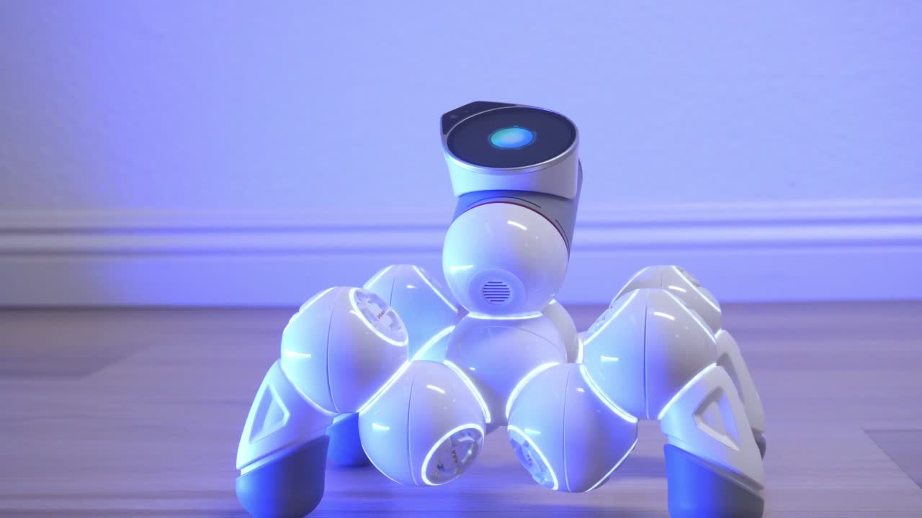
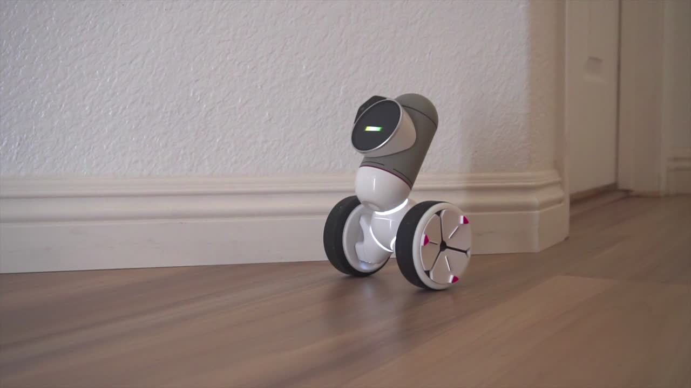
04
METHODOLOGY
Data Collection
Pre
processing
Model CREATION
Gather relevant data from diverse sources.
Clean, normalize, and engineer data.
Choose and train ML/DL algorithms for peak performance.

Slide 8

Methodologies Used in the Code :
Data Loading:
Used tensorflow.datasets.MNIST to fetch and split data into training and testing sets.
Data Transformation:
Applied ToTensor() to convert images into PyTorch tensors and normalize pixel values to [0, 1].
Data Visualization:
Used matplotlib.pyplot to display a 4x4 grid of sample images for inspection.
Data Inspection:
Checked the dataset's shape and dimensions to confirm the number of images and labels.
Minimal Preprocessing:
No additional preprocessing (like noise removal or null handling) as MNIST is clean and curated.

Slide 9

05
DATA

Slide 10
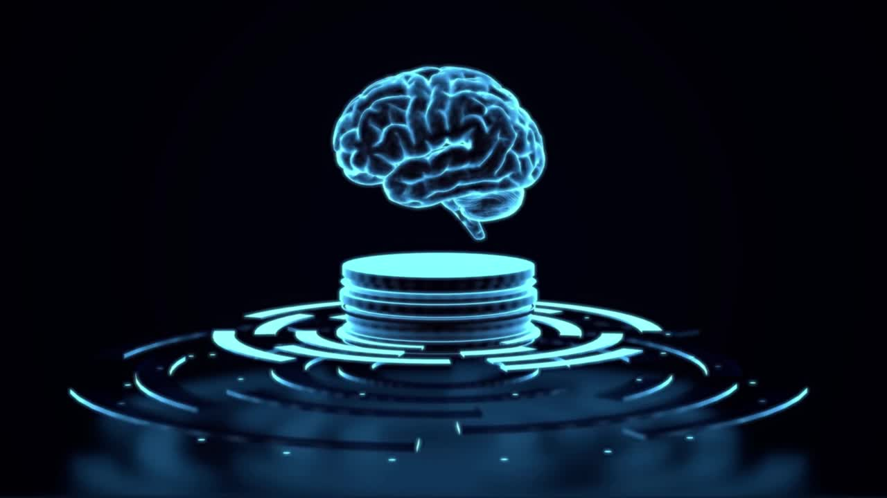
Dataset: MNIST
•• Contains 70,000 grayscale images of handwritten digits (0-9)
•• Each image is 28x28 pixels
•• Used for training and testing digit classification models.

Slide 11

Scope of MNIST Data
The MNIST dataset is widely used in machine learning and computer vision. Its key applications include:
Machine Learning Research:
Classifying handwritten digits.
Benchmarking algorithms and models.
Deep Learning Development:
Testing CNNs for image recognition.
Educational Use:
Teaching supervised learning, data preprocessing, and neural network training.
Real-world Use Cases:
Handwritten document digitization.
Optical character recognition (OCR).

Slide 12
Data Ingestion:
Data ingestion refers to the process of loading data into a system or program for further processing or analysis.
How MNIST Data is Ingested in the Code:
torchvision.datasets.MNIST is used to load the data.
Parameters:
root: Directory to store the data.
train: Loads training or test data.
download: Downloads the data if not already available.
transform: Converts the data into PyTorch tensors.
Process:
Download: Data is fetched if not present locally.
Read: Images and labels are loaded into memory.
Transform: Images are converted to tensors and normalized.

Slide 13
Data Wrangling:
Data wrangling is the process of cleaning and preparing data for analysis or training. For MNIST, this includes:
Data Cleaning:
MNIST is already clean, with no missing or invalid data.
Pixel values are often pre-normalized.
Data Transformation:
Images are converted into tensors using ToTensor().
Pixel values are scaled to the range [0, 1] by dividing by 255.
Normalization:
Helps ensure a consistent data distribution for faster training.
Data Splitting:
Training Set: 60,000 images.
Test Set: 10,000 images.
The train parameter in datasets.MNIST defines which set to load.

Slide 14
05
Data Preprocessing
•• NORMALIZE PIXEL VALUES TO RANGE [0,1]
•• Reshape data for CNN and RNN architectures
•• Apply one-hot encoding to labels
•• Data augmentation using ImageDataGenerator

Slide 15

06
MODEL
DEVELOPMENT
We built a CNN model to recognize handwritten digits from the MNIST dataset. It uses layers to extract features and classify digits, trained with optimization techniques for accuracy.

Slide 16


Development of Handwritten Digit Recognition AI Model:
Environment Setup:
Installed required libraries: torch, torchvision, matplotlib, numpy, pandas etc.
Dataset Loading:
Loaded the MNIST dataset using torchvision.datasets.MNIST.
Split into training and testing sets.
Data Transformation:
Used ToTensor() to scale image pixel values to [0, 1].
Data Visualization:
Displayed sample images with matplotlib for inspection.
Model Architecture:
Created a model following 3 ARCHITECTURES
CNN
RNN
SVM

Slide 17
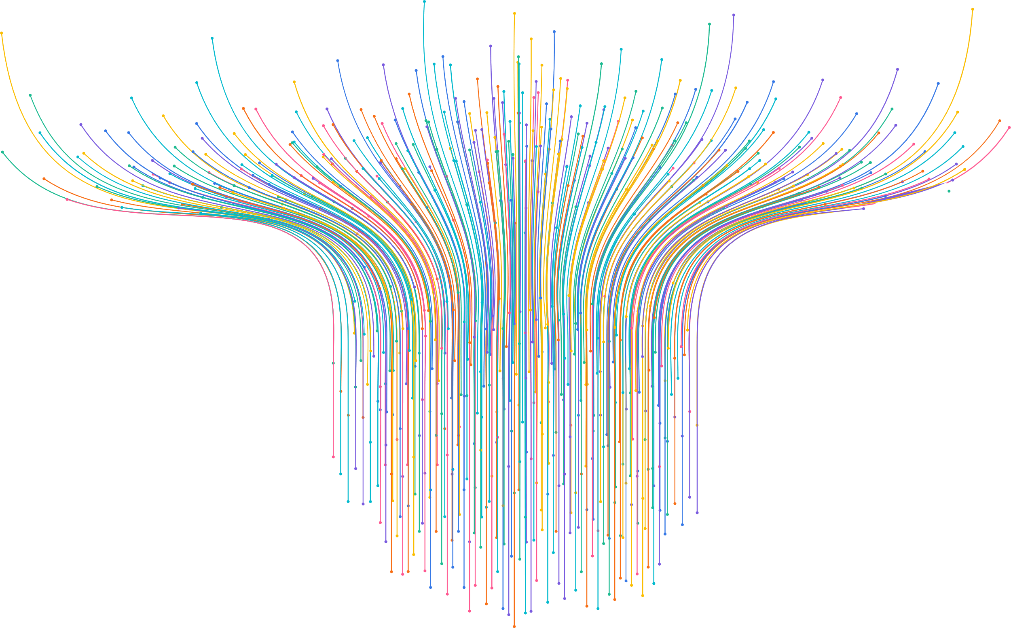
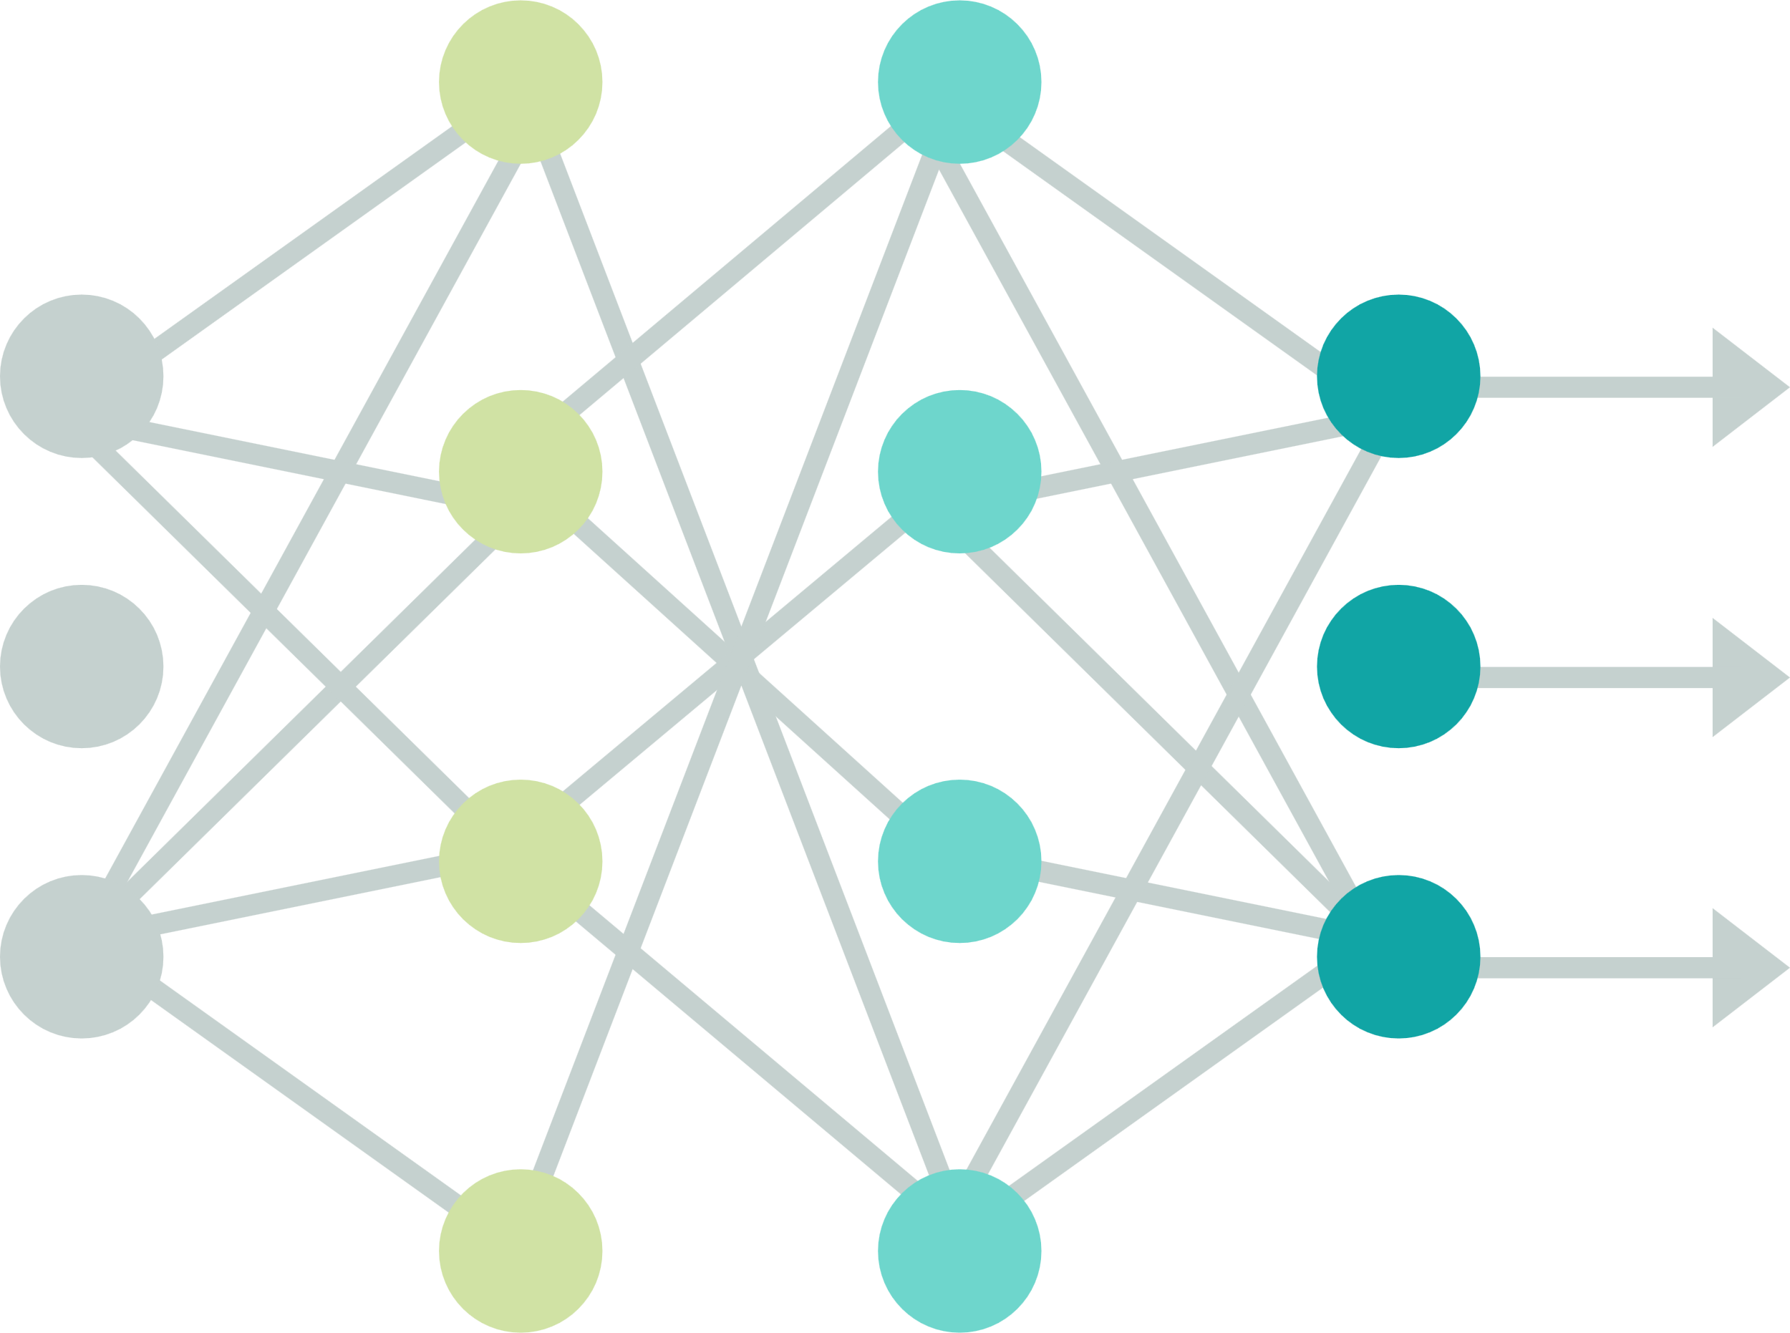
CNN MODEL
•• Uses convolutional layers for feature extraction
•• Pooling layers reduce spatial dimensions
•• Fully connected layers classify digits
•• Uses ReLU activation and Softmax for output.

Slide 18
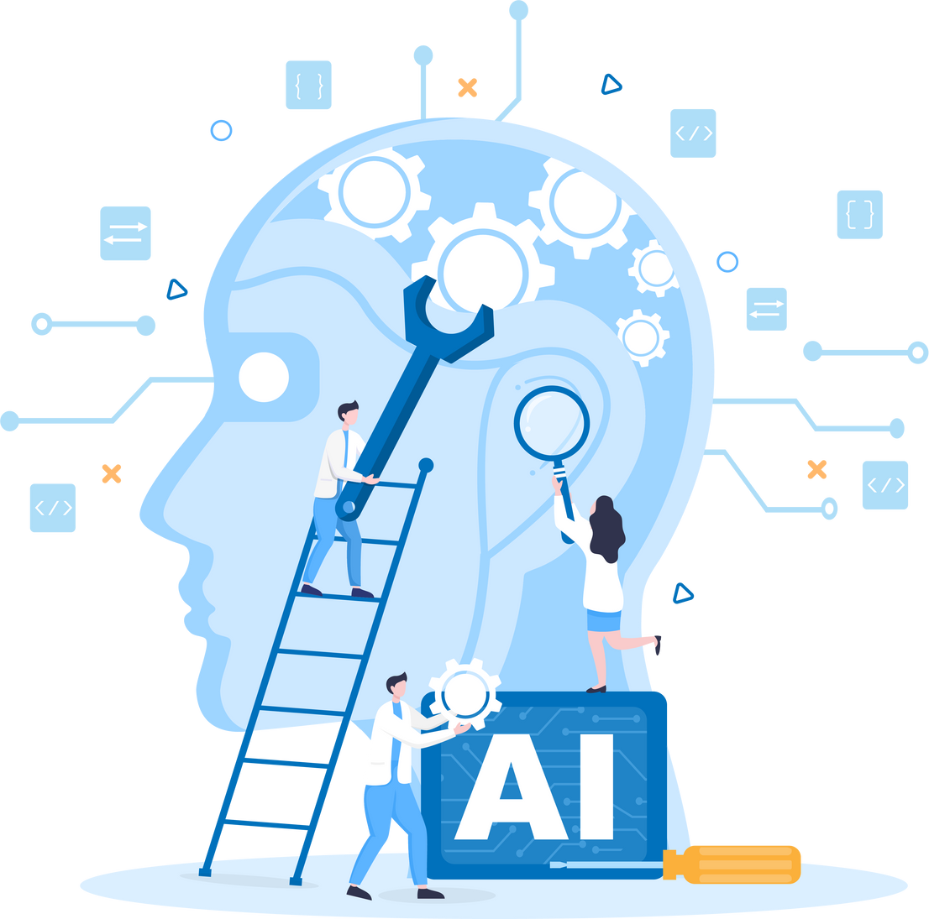
RNN (LSTM) Model
•• Processes sequential image data row-wise
•• LSTM layers capture temporal dependencies
•• Dense layers classify digits
•• Uses Softmax activation for multi-class classification.

Slide 19
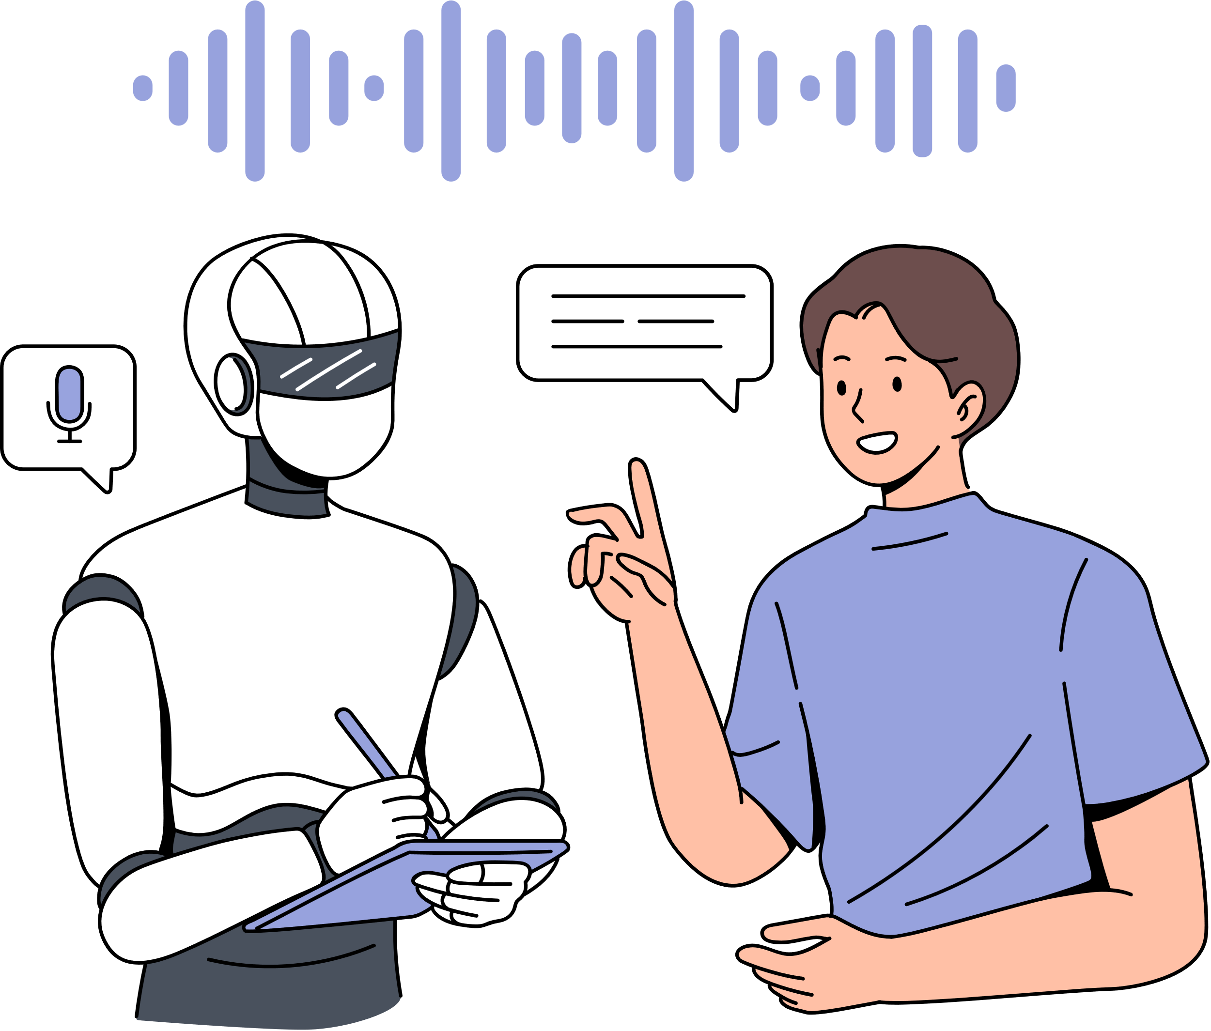
SVM Model
•• Uses flattened image data as input
•• Applies Support Vector Classification
•• Kernel trick for feature transformation
•• Works well on smaller datasets.

Slide 20
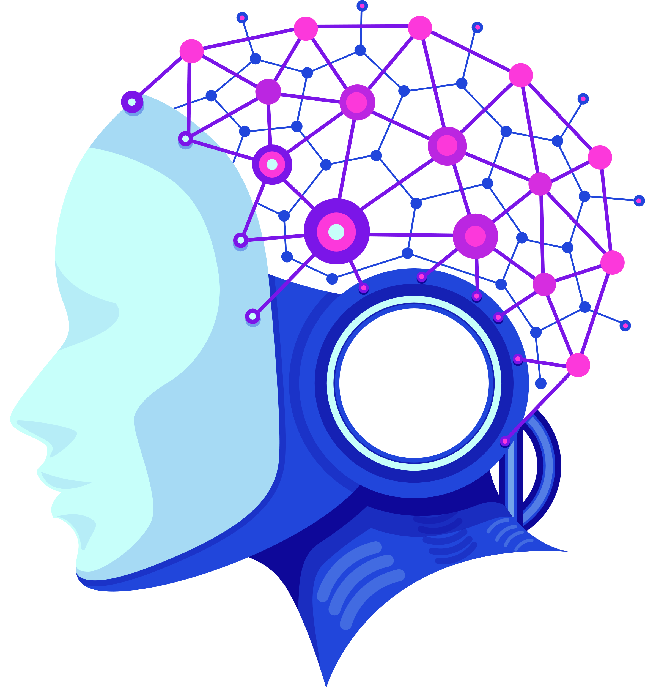
Model Training
•• CNN and RNN trained using Adam optimizer and categorical cross-entropy loss
•• SVM trained using linear kernel
•• Evaluated on MNIST test set.

Slide 21
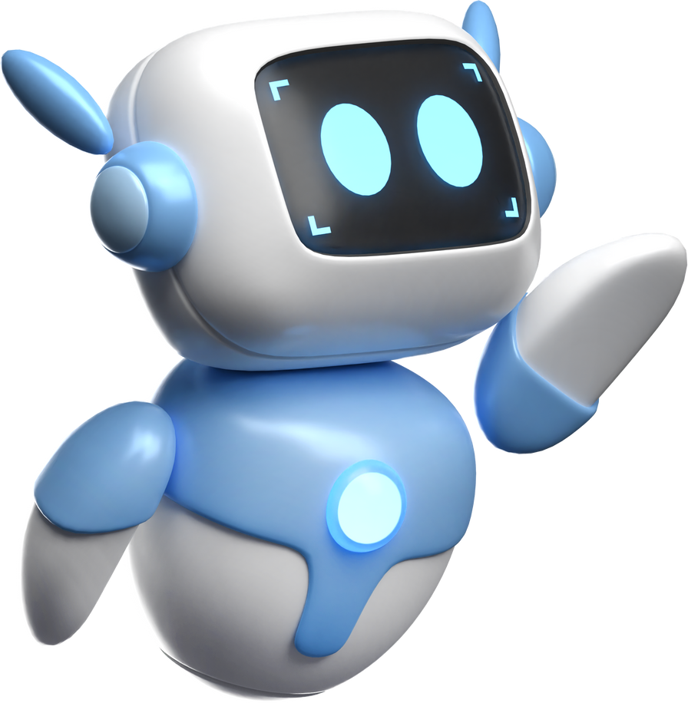
6. Training Process:
Used the Adam optimizer(advanced optimization algorithm) to update model parameters.
Applied Cross-Entropy Loss to measure prediction error.
Ran the model for 3 epochs with mini-batches of size 32.

Slide 22
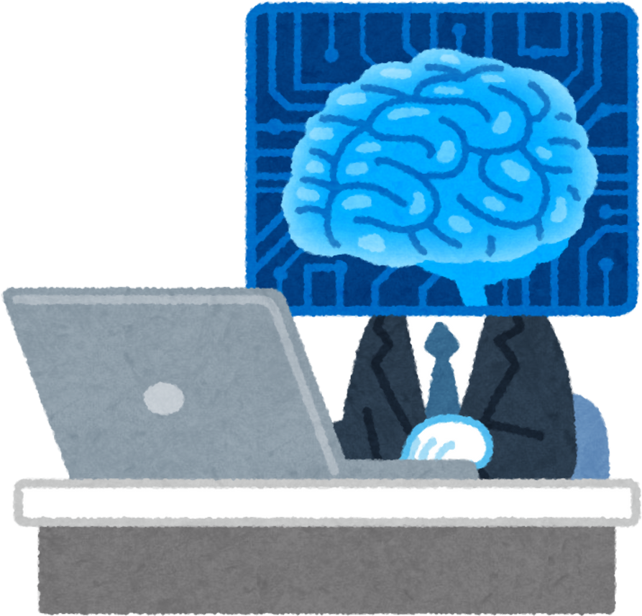
MODEL PERFORMANCE
•• CNN Accuracy: 98%
•• RNN Accuracy: 96%
•• SVM Accuracy: 92%
•• CNN outperforms other models in digit recognition.

Slide 23
MODEL PERFORMANCE
•• CNN provides the best performance for handwritten digit recognition.
•• RNN (LSTM) is useful for sequence-based tasks.
•• SVM is a good choice for small datasets but lacks scalability.

Slide 24
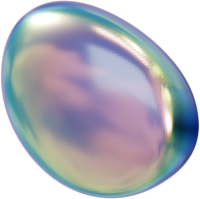
07
FUTURE DIRECTIONS
The future of handwritten digit recognition lies in enhancing accuracy, scalability, and real-world applications like banking and education while fostering AI innovation.

Slide 25

Usage of the model:
Banking and Finance:
Processing handwritten checks and forms.
Education:
Automatic grading of handwritten assignments.
Healthcare:
Digitizing handwritten medical prescriptions and records.
Postal Services:
Recognizing postal codes and addresses for mail sorting.
Document Digitization:
Converting handwritten notes into digital formats.
Authentication Systems:
Signature and handwriting verification.
Assistive Technologies:
Helping visually impaired individuals read handwritten text.
Historical Archives:
Digitizing and preserving ancient handwritten manuscripts.

Slide 26
RESULT
Presenting Code

Slide 27
THANK YOU
THYNK
UNLIMITED

